Slide 1

The ROI of Talent
Larry Sternberg
April 15, 2010

Slide 2
Private and Confidential
All materials constituting this presentation (the “Materials”) are confidential and proprietary property solely owned and copyrighted by Talent Plus ®, Inc. (“Talent Plus”). The Materials are intended for use only by the individual or entity that receives the Materials directly from Talent Plus (the “Recipient”) and such individuals associated with the Recipient on a “need to know” basis. The Materials shall not be copied, modified or otherwise reproduced by Recipient without the express written permission of Talent Plus.

Slide 3
Dr. Hall’s Dream
“What would the world be like if everybody did what they were good at and enjoyed?”
+ Dr. William E. Hall

Slide 4

ROI?

Slide 5


Slide 6
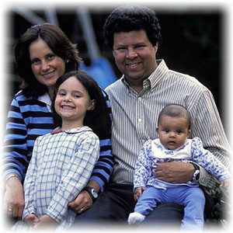

Slide 7
Talent?

Slide 8


Gabriel García Márquez
43
Copyright © 2008 Talent Plus | Lincoln, Nebraska

Slide 9

Shakira
43
Copyright © 2008 Talent Plus | Lincoln, Nebraska

Slide 10
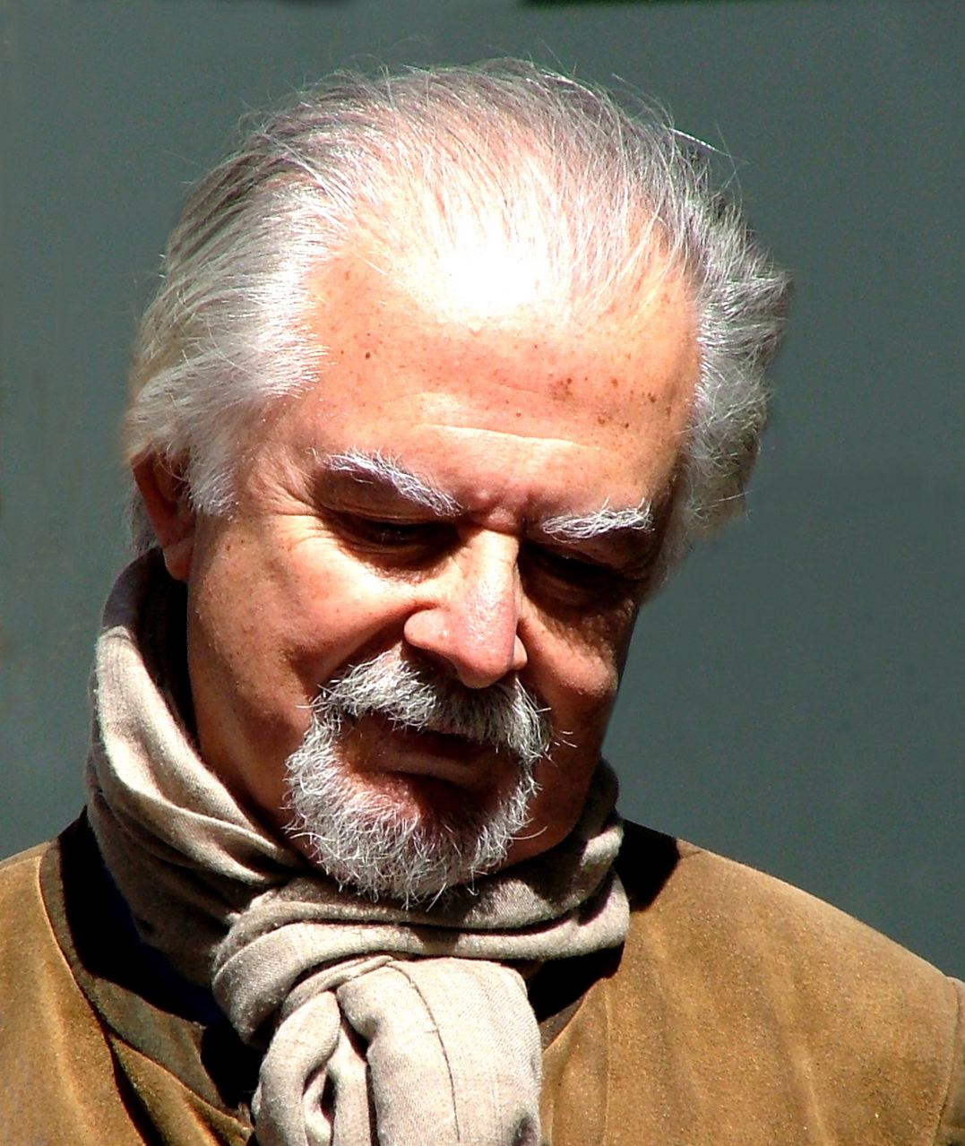
Fernando Botero
43
Copyright © 2008 Talent Plus | Lincoln, Nebraska

Slide 11

Camilo Villegas
43
Copyright © 2008 Talent Plus | Lincoln, Nebraska

Slide 12

Juanes
43
Copyright © 2008 Talent Plus | Lincoln, Nebraska

Slide 13

Sofía Vergara
43
Copyright © 2008 Talent Plus | Lincoln, Nebraska

Slide 14
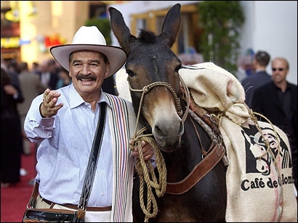
Fame is not Talent
43
Copyright © 2008 Talent Plus | Lincoln, Nebraska

Slide 15
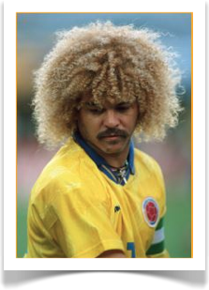
Carlos Valderama
43
Copyright © 2008 Talent Plus | Lincoln, Nebraska

Slide 16

(Talent + F) x I = G
Definition of Talent
A person’s capacity to achieve near-perfect performance.
A natural ability not acquired through effort.

Slide 17
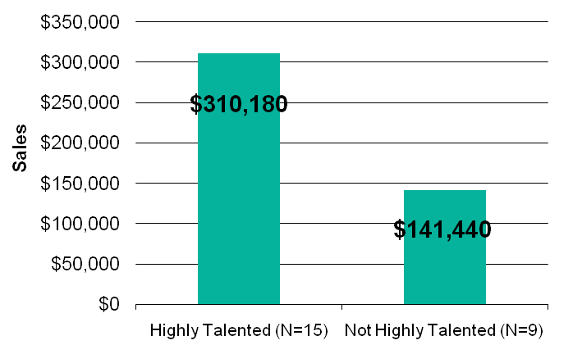
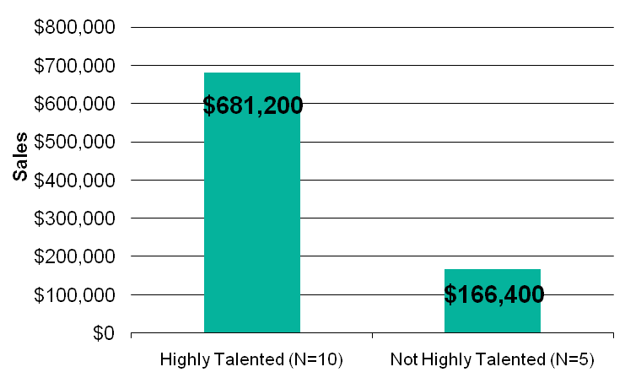
Talent Advantage ® – Construction Management
Sales Productivity
Year One
Increase of $168,740 per person in the first year alone. Total revenue increase: $2.5 million.
Year Two
Talented people outsold others by $514,800 per person.
12

Slide 18
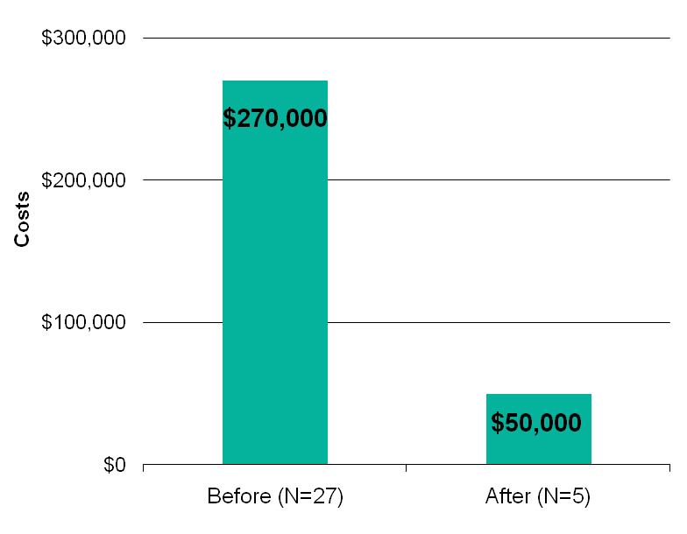
Talent Advantage ® – Financial Institution
New Hire and Retention Turnover
A financial institution reduced rotation in their check-processing area.
New-hire support staff rotation decreased by 38 percent in a 12-month period.
Based on a cost estimate of $10,000 per employee (or an average of six months’ salary), a savings of $220,000 annually was realized.
13

Slide 19
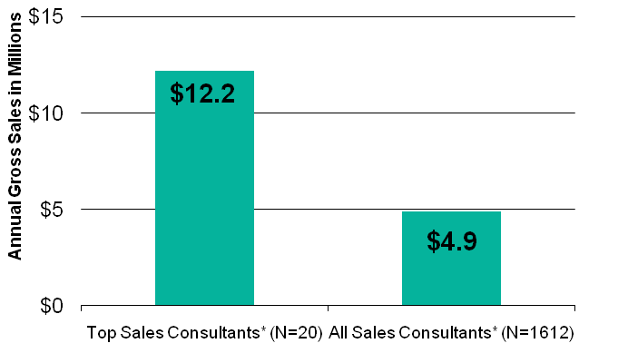
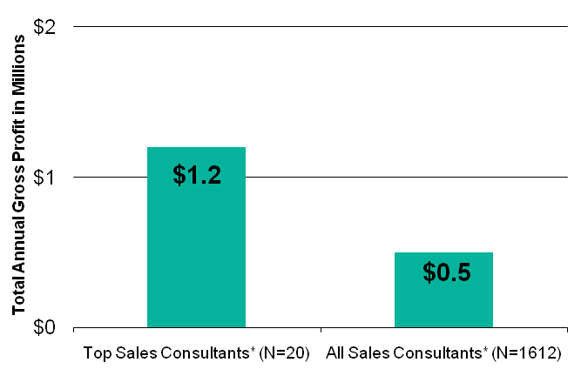
Talent Advantage ® – Automotive
Sales Productivity
Top sales consultants sold nearly three times the number of vehicles during one year compared to all sales consultants.
GROSS PROFIT ANALYSIS
Top sales consultants sell an average of 133 more vehicles per year than the average of all sales consultants.
*Employed 12 months or longer
28

Slide 20
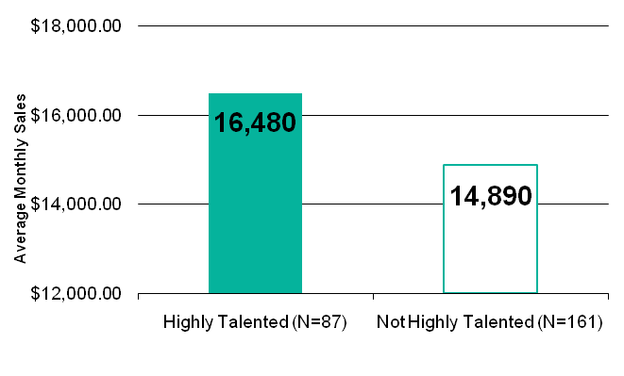
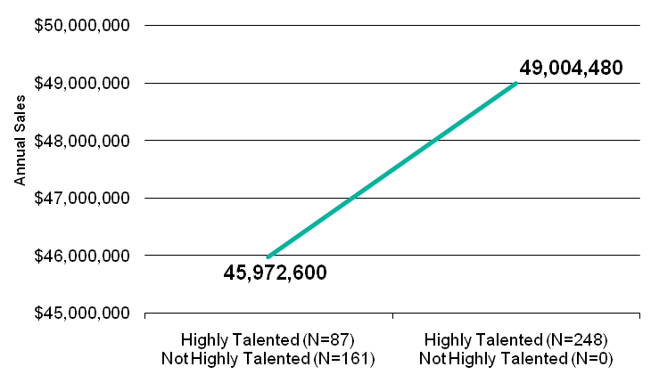
Talent Advantage ® – Financial Institution
While decreasing the size of the sales team this past year (from 1,600 to 800) they have seen an increase in productivity.
10% increase in sales exists between highly talented sales people and others
If all salespeople hire been highly talented, this client could have added an additional $1 million U.S. dollars in revenue.
58

Slide 21
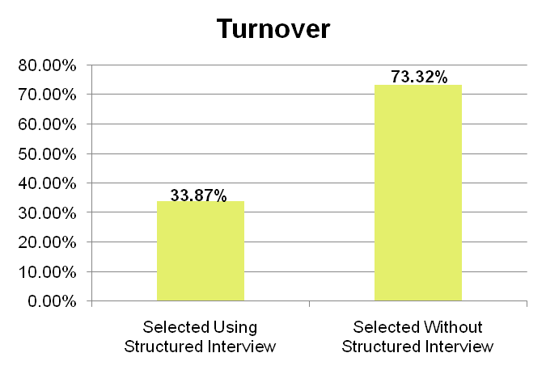
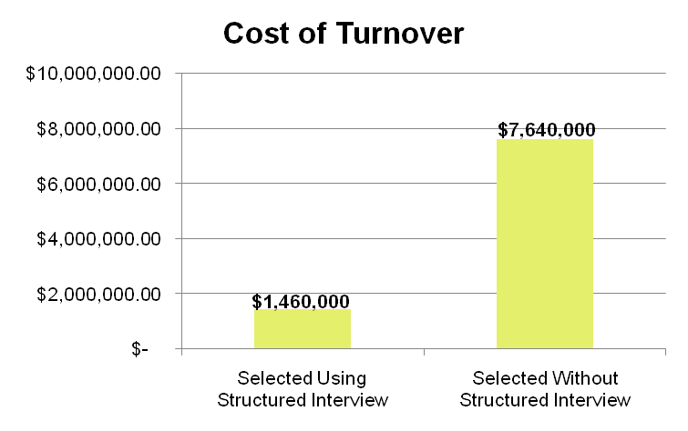
Talent SpeaksSM – Manufacturing Client Reduces Rotation
Manufacturing company has been able to save $6.5 million dollars through the reduction of turnover and by selecting highly productive employees.
71

Slide 22
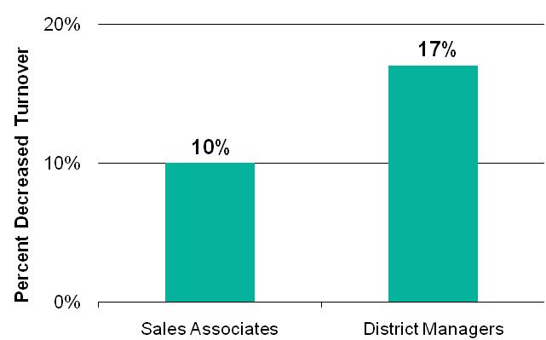
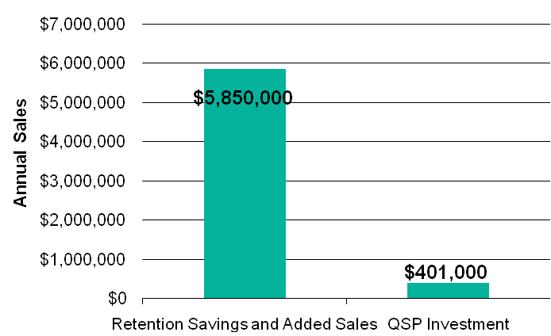
Talent Advantage ® – Retail
DECREASED ROTATION
Sales associates: reduced 10% (1,000 fewer hires)
District managers: decreased 17% (20 fewer hires).
FINANCIAL IMPACT
Rotation savings: $850,000 plus the
Increased sales: $5,000,000
Total gain of $5.8 million in just one fiscal year.
8

Slide 24
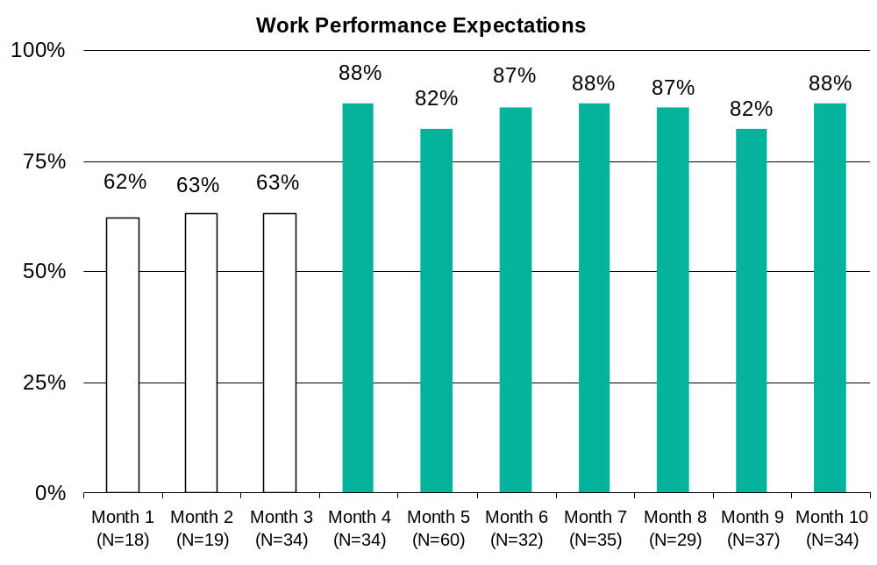
Talent Advantage ® – Health Care
Employee Performance
NEW HIRES’ QUALITY IMPROVEMENT SURVEY SCORES
This company found that scores previously well below the 65 percent mark rose as high as 88 percent in just six months.
3

Slide 25
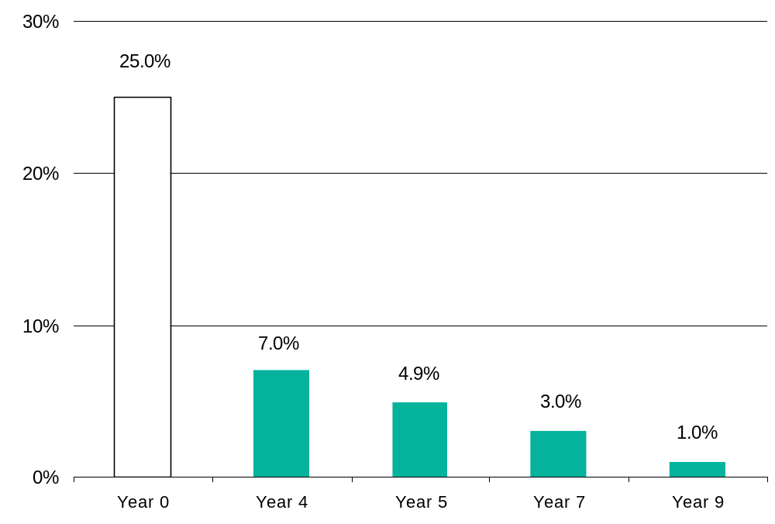
Talent Advantage ® – Hospitality
Employee Performance
DECREASED CUSTOMER COMPLAINTS
3

Slide 26
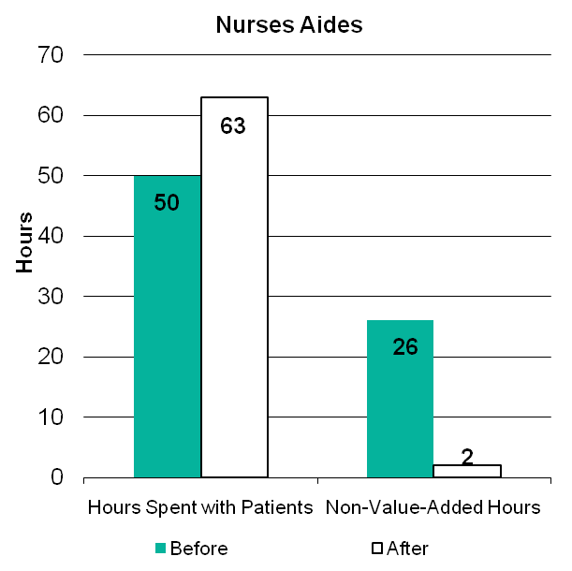
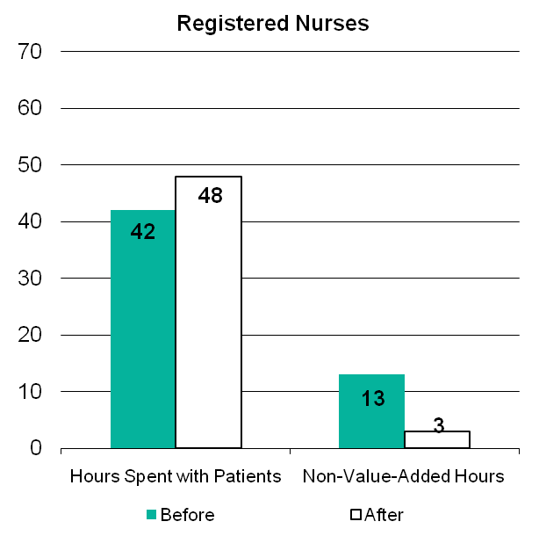
Talent Advantage ® – Health Care Employee Efficiency and Effectiveness
QUALITY PATIENT HOURS vs. NON-VALUE-ADDED TIME
4

Slide 27
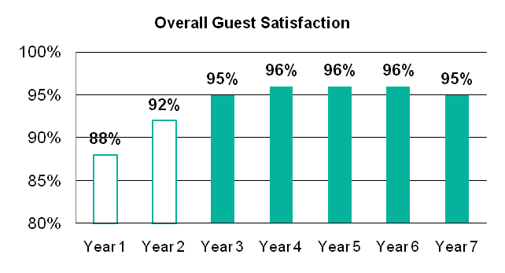
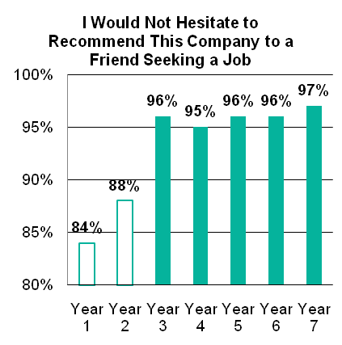
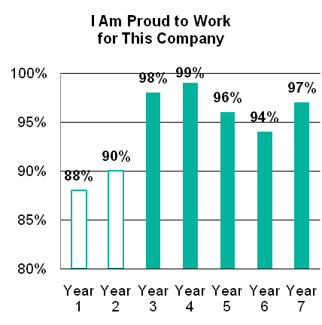
Talent Advantage ® – Hospitality
Talented Culture Leads to Satisfaction
GUEST SATISFACTION
When this company focused on selecting highly talented employees, guest satisfaction scores of this particular hotel increased from 88 to 95 percent over seven years.
EMPLOYEE ENGAGEMENT
This hotel property also saw increases in employee engagement survey scores.
60

Slide 28
How do I get this ROI?

Slide 29

Lucy, Lucy, Lucy!

Slide 30
Economic Value Add (EVA)
By Superior Performance
Low Job Complexity =
119% Increased Productivity
Hunter, J. E., F. L. Schmidt & M. K. Judiesch. “Individual Differences in Output Variability as a Function of Job Complexity.”
Journal of Applied Psychology 75, 1990,

Slide 31
Economic Value Add (EVA)
By Superior Performance
Moderate Job
Complexity =
132% Increased Productivity
Hunter, J. E., F. L. Schmidt & M. K. Judiesch. “Individual Differences in Output Variability as a Function of Job Complexity.”
Journal of Applied Psychology 75, 1990,

Slide 32
Economic Value Add (EVA)
By Superior Performance
High Job Complexity =
148% Increased
Productivity
Hunter, J. E., F. L. Schmidt & M. K. Judiesch. “Individual Differences in Output Variability as a Function of Job Complexity.”
Journal of Applied Psychology 75, 1990,

Slide 33
Talent and Productivity
Meta Analysis
Top 1% Productivity vs. Average Productivity
Low Complexity | The top performs _____% better than the average.
Medium Complexity | The top performs _____% better than the average.
High Complexity | The top performs _____% better than the average.
52
85
127
Top 1% Productivity vs. Bottom 1% Productivity
Low Complexity | The top performs _____% better than the bottom.
Medium Complexity | The top performs _____% better than the bottom.
High Complexity
300
1,200
Too high to measure

Slide 34
The Best Performer I Have Ever Known
Describe the best performer you have ever known. Use your own adjectives, phrases, or other descriptions that fit your perception as to why they are the best.
1.
2.
3.
4.
5.
6.
7.
8.
9.
10.

Slide 35
Talent Plus ® Growth Formula

Slide 36
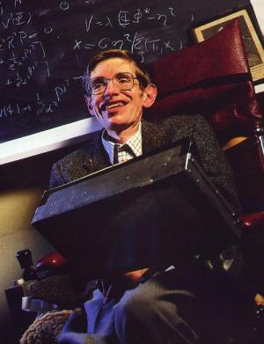
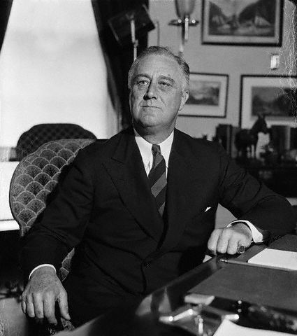
Understand the Talents

Slide 37

Cast in Right Fit

Slide 38

Invest

Slide 39
Dr. Hall’s Dream
“What would the world be like if everybody did what they were good at and enjoyed?”
+ Dr. William E. Hall

Slide 40
Human Investment Planning
Rank the people you manage starting with your best performer first and concluding with your least effective performer.
Rank the people you manage starting with the person with whom you spend the most individual (one-on-one) time and concluding with the person with whom you spend the least of your time.
Managing means making the strengths of people effective. Neither the welfare approach, nor the personnel management approach, nor the control-and-firefighting approach address themselves to strength, however.
People are weak; most of us are pitifully weak. People cause problems, require procedures, create chores, and people are a cost and a potential “threat.” But these are not the reason why people are employed. The reason is their strength and their capacity to perform.
Peter Drucker, “Management: Tasks, Responsibilities, Practices,” 1973

Slide 41

Relationship

Slide 42
Build the Strengths,
Make the Weaknesses Irrelevant

Slide 43

Jose Feliciano

Slide 44
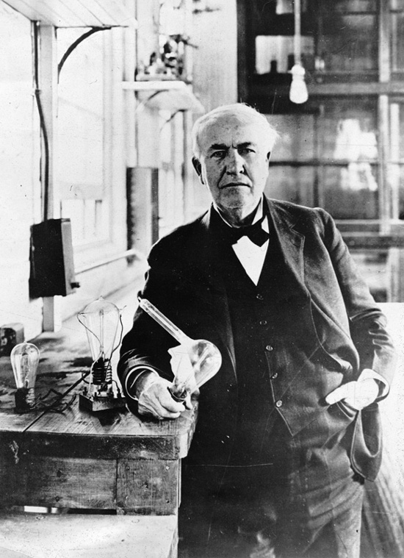
Thomas Edison

Slide 45
Stephen Hawking

Slide 46
Franklin D. Roosevelt

Slide 47

Michael Phelps

Slide 48
The Secret to Retention

Slide 49
The Secret to Retention
Meet their needs
Ask them!

Slide 50
The Two Most Important Questions
Can I?
Do I want to?

Slide 51
What about the Millennials?

Slide 52
Make a Difference in Their Lives

Slide 53
Life’s Board of Directors
As chairperson of my life’s board of directors, who are the board members who sit with me?
Around the table, write the initials/names of your life’s board members whose lives have influenced you and whose influence continues to be reflected in your everyday life.

Slide 54
Summary
Hold out for highly talented people
Put them in the right fit for their strengths
Grow the strengths, make the weaknesses irrelevant
Meet their needs
Make a difference in their lives

Slide 55
Companies are Known by the People They Keep ®

